Slide 1

CMOS VLSI Design
By
Dr.Rohit Lorenzo
Assistant Professor Sr. Grade -1
School of Electronics Engineering (SENSE)

Slide 2
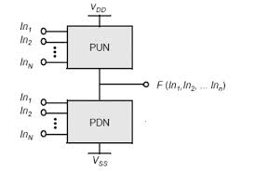
Static CMOS Complementary Logic
Static CMOS gates are implemented by using combination of two networks, the pull-up network (PUN) and Pull-down Network (PDN).
Advantage –
Very good current driving capability.
High Noise Margin.
Lower static power dissipation
Dis-advantage –
Larger number of transistors required
(larger chip area & delay).
Short circuit power dissipation.

Slide 3
Pseudo-nMOS Logic
An n-input pseudo nMOS requires n+1 transistors compared to 2n transistors of the corresponding static CMOS gates.
There is substantial reduction in area and delay.
But, the static power dissipation is much higher.

Slide 4
comparison of Static CMOS and Pseudo nMOS
 | Static CMOS | Pseudo nMOS
1 | Large area | Smaller area
2 | Longer delay | Smaller delay
3 | No Static power dissipation | Static power dissipation

Slide 5
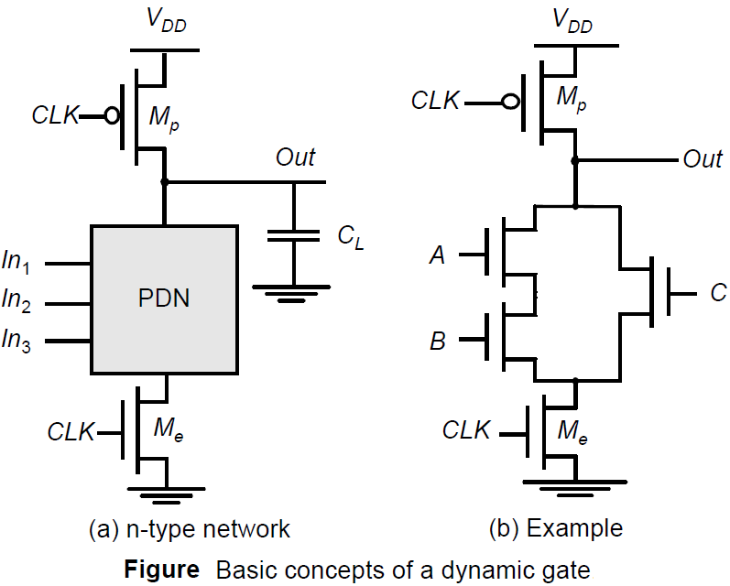
Dynamic CMOS Design
The basic construction of an (n-type) dynamic logic gate is shown in Figure. The PDN is constructed exactly as in complementary CMOS.
The operation of this circuit is divided into two major phases: precharge and evaluation, with the mode of operation determined by the clock signal CLK.

Slide 6
Continue…..
Pre-charge Phase
When CLK = 0, the output node Out is precharged to V_{DD} by the PMOS transistor M_{p}. During that time, the evaluate NMOS transistor Me is off, so that the pull-down path is disabled.
Evaluation Phase
For CLK = 1, the precharge transistor Mp is off, and the evaluation transistor Me is turned on. The output is conditionally discharged based on the input values and the pull-down topology.
If the PDN is turned off, the precharged value remains stored on the output capacitance C_{L}. once Out is discharged, it cannot be charged again till then next precharge operation. Notice that the output can be in the high-impedance state during the evaluation period if the pull-down network is turned off.
During the precharge phase (CLK=0), the output is precharged to V_{DD} regardless of the input values since the evaluation device is turned off.During evaluation (CLK=1), a conducting path is created between Out and GND if (and only if) A·B+C is TRUE. Otherwise, the output remains at the precharged state of V_{DD}.
The following function is thus realized:

Slide 7
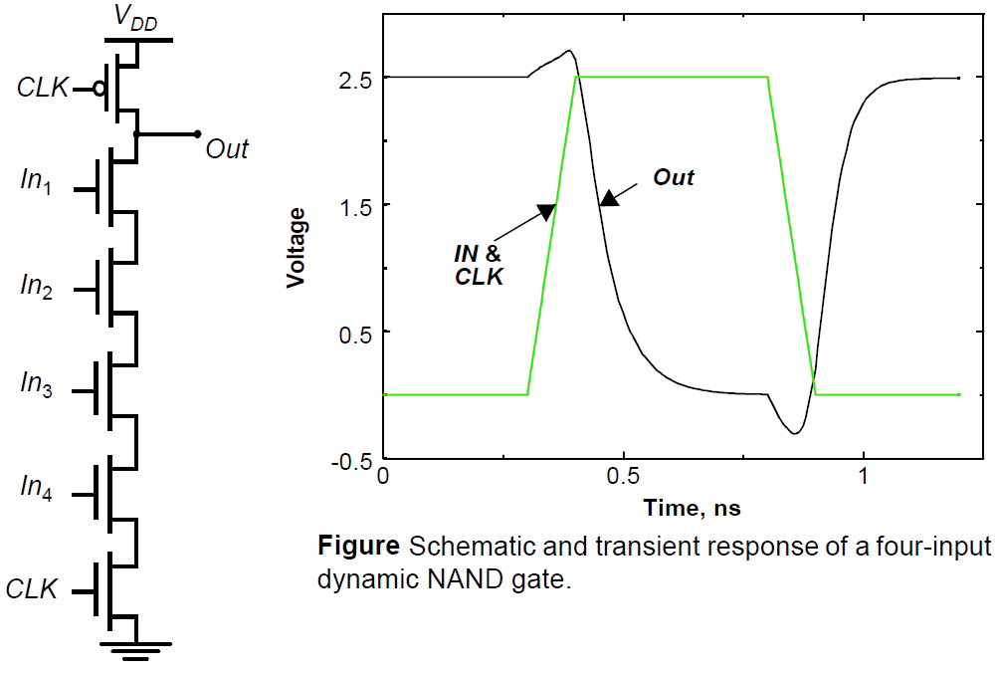
Speed and Power Dissipation of Dynamic Logic
The main advantages of dynamic logic are increased speed and reduced implementation area. Fewer devices to implement a given logic function implies that the overall load capacitance is much smaller.

Slide 8
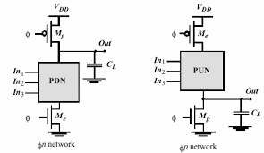
Dynamic CMOS with Pull-up network(PUN) and Pull-down Network (PDN)

Slide 9
Advantages
The number of transistor required for a circuit with fan-in N is (N+2), in contract to 2N in case of state CMOS circuits.
The load capacitance is more than 50% less than static CMOS and is closer to that of nMOS circuits.
The speed of operation is faster than that of static CMOS circuits.
Lower static power dissipation. (Its only consumes dynamic power)
No short circuit power dissipation.
No glitching power dissipation.
It is non-ratioed. The sizing of the PMOS precharge device is not important for realizing proper functionality of the gate. The size of the precharge device can be made large to improve the low-to-high transition time. There is however, a trade-off with power dissipation since a larger precharge device directly increases clock-power dissipation.

Slide 10
Disadvantages
Charge leakage problem
Charge sharing problem
Clock Skew Problem

Slide 11
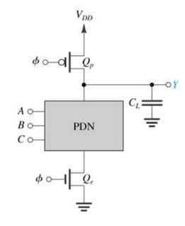
Charge Leakage Problem
The operation of the dynamic gate depends on the storage of information in the form of charge on the capacitor.
During pre-charge phase C_{L} is charge but how long the voltage on
C_{L} is retain.
Suppose clock period is too long, in that case capacitor is discharge
through NMOS network.

Slide 12
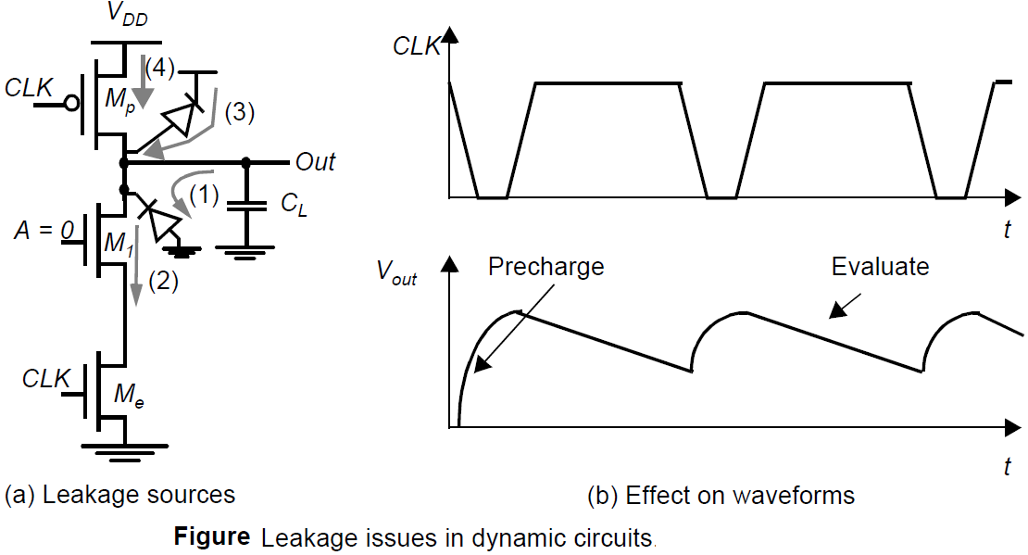
Continue….
The output should ideally remain at the precharged state of V_{DD} during the evaluation phase. However, this charge gradually leaks away due to leakage currents, eventually resulting in a malfunctioning of the gate

Slide 13
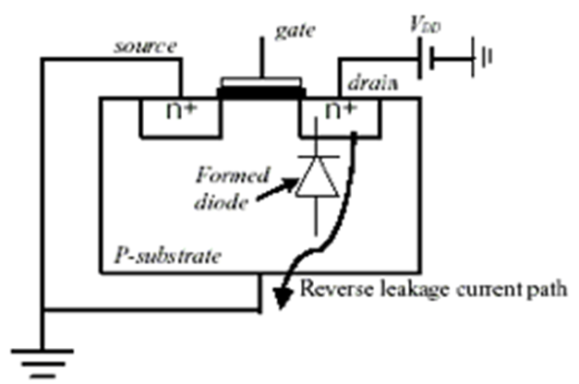
Continue…..
Source 1 and 2 are the reverse-biased diode and sub-threshold leakage of the NMOS pull-down device M1, respectively. The charge stored on C_{L} will slowly leak away due these leakage sources.
Note that the PMOS precharge device also contributes some leakage current due to the reverse bias diode (source 3) and the subthreshold conduction (source 4).
If this reverse current for long duration the capacitor will discharge leading to degradation in output level.
The output may degrade to such a level, which will be treated as low level. So we need to prevent this.

Slide 14
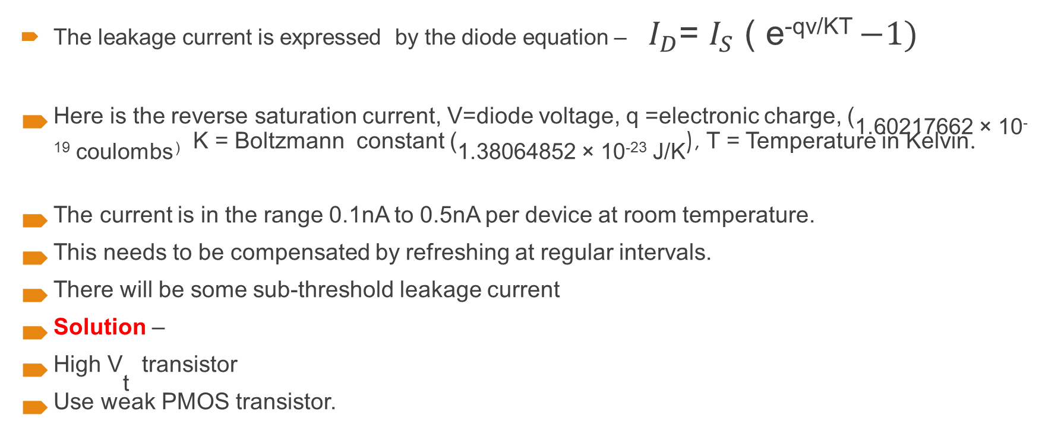
Continue…..
The leakage current is expressed by the diode equation – ${ I}_{D}$= $I_{S}$ ( e^{-qv/KT} $−1)$
Here is the reverse saturation current, V=diode voltage, q =electronic charge, (1.60217662 × 10⁻¹⁹ coulombs ^{) K = Boltzmann constant (}1.38064852 × 10⁻²³ J/K^{), T = Temperature in Kelvin.}
The current is in the range 0.1nA to 0.5nA per device at room temperature.
This needs to be compensated by refreshing at regular intervals.
There will be some sub-threshold leakage current
^{Solution –}
^{High V}_{t} ^{transistor}
^{Use weak PMOS transistor.}

Slide 15
Charge sharing Problem
In Pre-charging phase load capacitor (C_{L}) is charge to V_{dd} .
So the total charge Q = V_{dd.}C_{L.}
In Evaluation phase if ABC = 111 then C_{L} will discharge to ‘0’
If input is ABC = 110 , then after redistribution of charge the out node
will attain the value suppose V_{A}

Slide 16
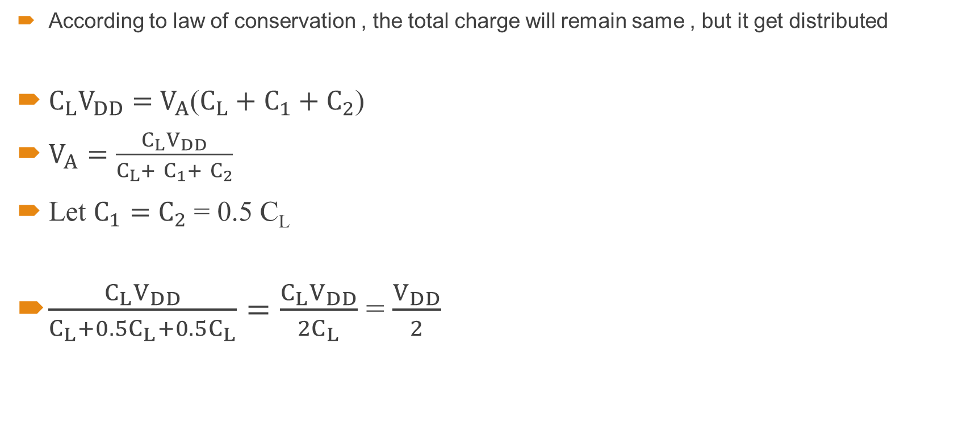
Continue…..
According to law of conservation , the total charge will remain same , but it get distributed
$C_{L}V_{DD}=$ $V_{A}$($C_{L}+$ $C_{1}+$ $C_{2}$)
$V_{A}=\frac{C_{L}V_{DD}}{C_{L}+ C_{1}+ C_{2}}$
Let $C_{1}=$ $C_{2}$ = 0.5 C_{L}
$\frac{C_{L}V_{DD}}{C_{L}+{0.5C}_{L}+0.5C_{L}}=\frac{C_{L}V_{DD}}{{2C}_{L}}$ = $\frac{V_{DD}}{2}$

Slide 17
Continue…..
So after distribution the charge remain to V_{DD}/2 because of parasitic capacitance present on the internal node.
The charge that was present during the pre-charging mode get distributed leading to reduction in output voltage which may be treated as low level. So this problem is called charge sharing problem.

Slide 18
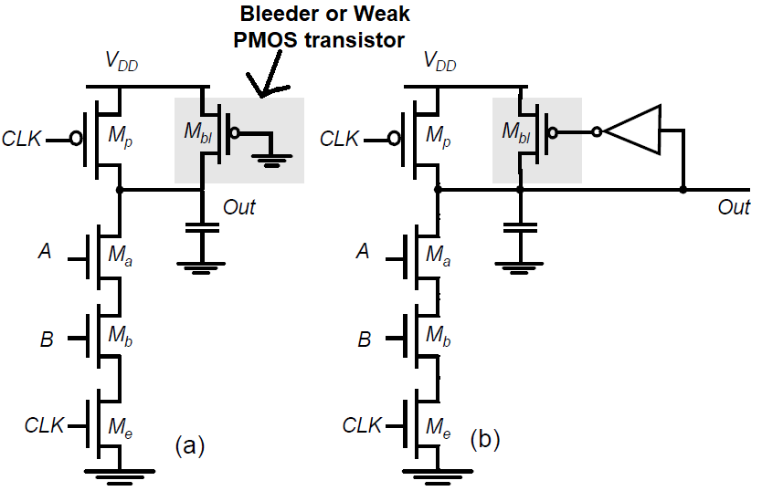
How to Overcome charge leakage and sharing problem
This problem can be overcome by using a weak pMOS transistor (bleeder transistor) . This is also used to overcome the problem of charge leakage problem. So, a weak pMOS is added as pull-up transistor, this transistor always remains on and behaves like a pseudo n- MOS circuit during evaluation period.
by weak I mean that resistance is very high. In other words the current that it will supply is very small, when the resistance is high current that will be, it will supply to the load capacitance will be small, and as a consequence it will replenish the charge that is lost; either due to leakage problem or due to charge sharing problem.

Slide 19
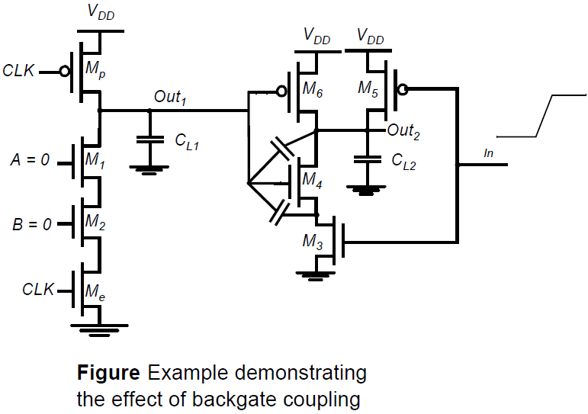
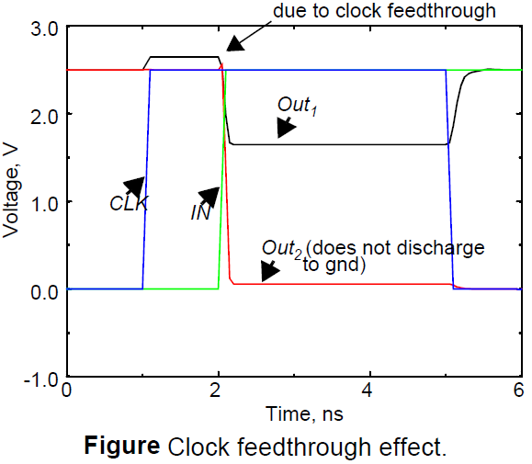
Capacitive Coupling
The high impedance of the output node makes the circuit very sensitive to crosstalk effects. A wire routed over a dynamic node may couple capacitively and destroy the state of the floating node.
A transition in the input In of the static gate may cause the output of the gate (Out2) to go low.

Slide 20
Continue….
This output transition couples capacitively to the other input of the gate, the dynamic node Out1, through the gate-source and gate-drain capacitances of transistor M4.
This further causes the output of the static NAND gate not to drop all the way down to 0V. Consequently, the circuit can evaluate incorrectly.
Clock-Feedthrough
A special case of capacitive coupling is clock-feedthrough, an effect caused by the capacitive coupling between the clock input of the precharge device and the dynamic output node.
This capacitive coupling causes the output of the dynamic node to rise above V_{DD} on the low-to-high transition of the clock, assuming that the pull-down network is turned off. Sometime they may lead to faulty operation.
All the above considerations demonstrate that the design of dynamic circuits is rather tricky and requires extreme care.

Slide 21
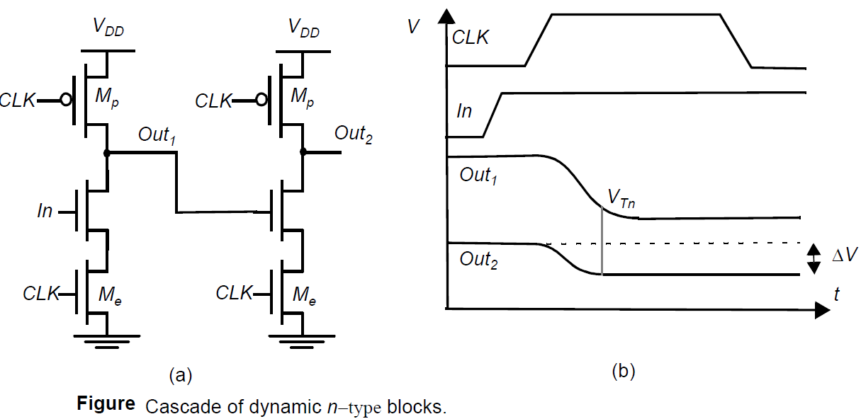
Cascading Dynamic Gates
Besides the signal integrity issues, there is one major catch that complicates the design of cascaded dynamic circuits.
During the precharge phase (i.e., CLK =0), the outputs of both inverters are precharged to V_{DD.} Assume that the primary input In makes a 0 1 transition (Figure 6.64b). On the rising edge of the clock output Out1 starts to discharge.
The second output should remain in the
precharged state of V_{DD} as its expected
value is 1.
There is a finite propagation delay for the
input to discharge Out1 to GND.
Therefore, the second output also starts
to discharge. Because of this precious
charge is lost.

Slide 22
Continue….
This leaves Out2 at an intermediate voltage level. The correct level will not be recovered. The charge loss leads to reduced noise margins and potential malfunctioning.

Slide 23
Clock Skew Problem
Clock skew problem arises in dynamic CMOS circuits, particularly whenever you are realizing multilevel circuits.
Clock skew problem arises, because you have to distribute the clock throughout the entire circuit, but the depending on the clock tri-network, the clock signal can reach different points of the circuit at different points of the time, because of different amounts of delay of the clock tree network.
Furthermore, this delay due to resistance and parasitic capacitance associated with the wire. It result in hazard and race condition (or incorrect output).
This problem can be overcome by setting the output low during pr-charge.

Slide 24
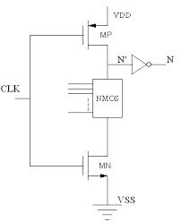
Domino CMOS Circuits
The problem with faulty discharge of Pre-charged nodes in CMOS dynamic logic circuits can be solved by placing an inverter in series with the output of each gate.
Domino gate consist of two distinct components:
The first component is a conventional nMOS gate.
The second component is a static inverting CMOS buffer.
For example, during pre-charge you are applying a inverter
here. So, when it is high, then this is low.

Slide 25
continue…..
So, this cannot really discharge and then you can realize the circuit , it will always get correct output irrespective of this delay in irrespective of this clock skew problem . so; that means, even if the clock arises late to the first stage, it will not lead to premature discharge of this capacitor during evaluation phase of the stage and pre-charge phase of the previous stage.
The introduction of the static inverter has the additional advantage that the fan-out of the gate is driven by a static inverter with a low impedance output, which increases noise immunity. The buffer furthermore reduces the capacitance of the dynamic output node by separating internal and load capacitances
Advantages
Low power consumption
Reduced chip area
Higher speed of operation
No short circuit power dissipation
No glitching power dissipation

Slide 26
Limitations:
Each gate requires an inverter buffer
All gates are non-inverting in nature
Higher switching activity
How to deal with non-inverting property of domino logic ?
Re-organize the logic using bubble shifting to transform the circuit.
Dual rail domino logic.
Rohit Lorenzo, VIT-AP

Slide 27
Bubble Shifting

Slide 28
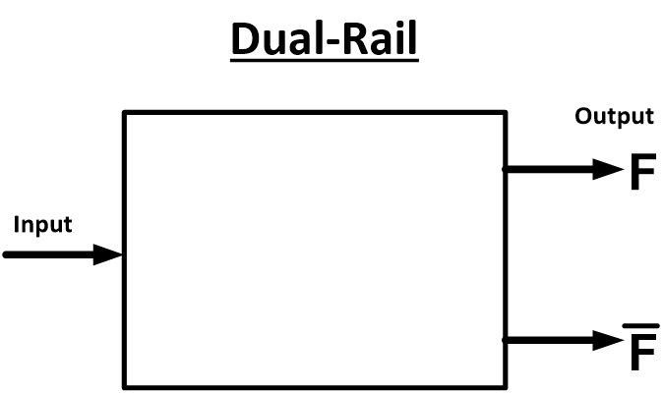
Dual Rail
we are applying input and producing F, in addition to F you will be also realizing F bar; that means, you are converting a dual rail circuit; that means, basic domino circuit can be modified to realize F as well as F bar simultaneously. Then it will be you know wherever inverter is required will be applying inverter. So, it is no longer realizing only positive unit function, because it is realizing positive unit and its compliment

Slide 29
NORA CMOS Logic (NP-Domino Logic)
NORA stands for No Race
By alternatively using p-blocks and n-blocks, the clock skew problem is overcome in NORA logic circuits.
we have seen that the, when during pre-charge the previous stage is disturbing the next stage if it is in the evaluation phase. Now, if it is a pMOS transistor, then a high level output will not disturb it. So, what we are doing, we are using alternatively a n-MOS block followed by pMOS block .

Slide 30
Continue….
Compared to domino technique, this approach gives higher flexibility.
Both inverted and non-inverted signals are available from NORA- technique.
The DEC-alpha processor, the first 250 MHz CMOS microprocessor, made extensive use of NORA logic Circuits.

Slide 31
Static CMOS full - Adder

Slide 32
NORA CMOS realization of full adder circuit

Slide 33
Thank You

